Slide 1
Project Presentation of Industry Oriented Hands on Experience (22CS422)
On
Smart AI System for Short Video Ad Creation
Abhavya Gupta
2210990025
Rittika Tyagi
2210990732
Supervised By
Gurpreet Singh
Department of Computer Science and Engineering,
Chitkara University, Punjab

Slide 2
Introduction
Short video advertisements have become one of the most effective tools in digital marketing, especially with the rise of platforms like Instagram Reels, YouTube Shorts, and TikTok. These platforms attract a large audience and enable businesses to promote their products in an engaging and visually appealing way. However, creating such ads manually requires significant time, creativity, and technical expertise. This makes it challenging for many users to consistently produce high-quality content. To address this issue, artificial intelligence can be leveraged to automate and optimize the process of short video ad creation, making it faster, easier, and more efficient.
2

Slide 3
Problem Statement
Businesses and individuals often struggle to create high-quality advertisement content due to the high cost, time consumption, and need for professional skills in photography, video editing, and graphic design. Traditional ad creation requires organizing photoshoots, hiring models, editing visuals, and producing videos, which is not accessible for small businesses, startups, or individuals. Additionally, with the rise of short-form video platforms, there is an increasing demand for engaging video ads, making content creation even more challenging and resource-intensive.

Slide 4
Our Solution
The AI Short Video Ads Generator provides an automated and intelligent solution to simplify advertisement creation. The system allows users to upload a product image and a model image, and uses AI-based image generation to seamlessly combine them into a realistic, advertisement-ready visual. It further extends this functionality by automatically generating short video ads from these visuals, making them suitable for modern digital marketing platforms. By eliminating the need for manual editing, photoshoots, and technical expertise, the system reduces cost, saves time, and enables users to quickly create high-quality, engaging promotional content using accessible AI technologies.

Slide 5
Key Features
AI Image Fusion
Combines product and model images into a realistic ad image.
Optional Prompt Control Users can add a prompt to customize style and look.
Auto Video Creation Turns images into a structured ad video with smooth flow.
Voice-over Generation Generates natural AI voice for the ad content.
Background Music Adds suitable music based on ad mood and theme.

Slide 6
Technologies Used
PERN Stack (Core Technology) The project is built using PostgreSQL, Express.js, React, and Node.js for full-stack development.
Neon Database (PostgreSQL - Cloud) Neon is used as a serverless PostgreSQL database to store user data, ad content, and video details with high scalability.
Express.js (Backend Framework) Handles API requests and manages communication between frontend and database efficiently.
React (Frontend) Builds a dynamic and responsive user interface using component-based architecture.

Slide 7
Technologies Used
Node.js (Runtime Environment) Executes server-side logic and supports scalable backend operations.
Clerk (Authentication) Provides secure user authentication, including login, signup, and session management.
Gemini API (AI Integration) Used for generating ad scripts and intelligent content using AI capabilities.
Data Sanitization Ensures user inputs are cleaned and validated to prevent errors and security issues.

Slide 8
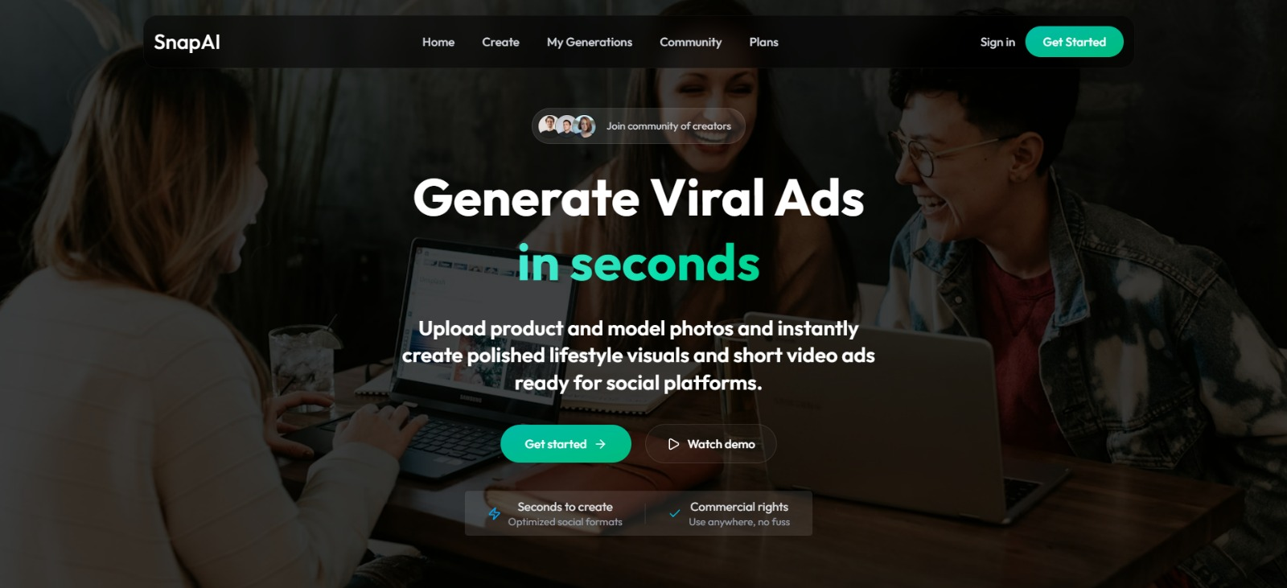
Screenshots

Slide 9
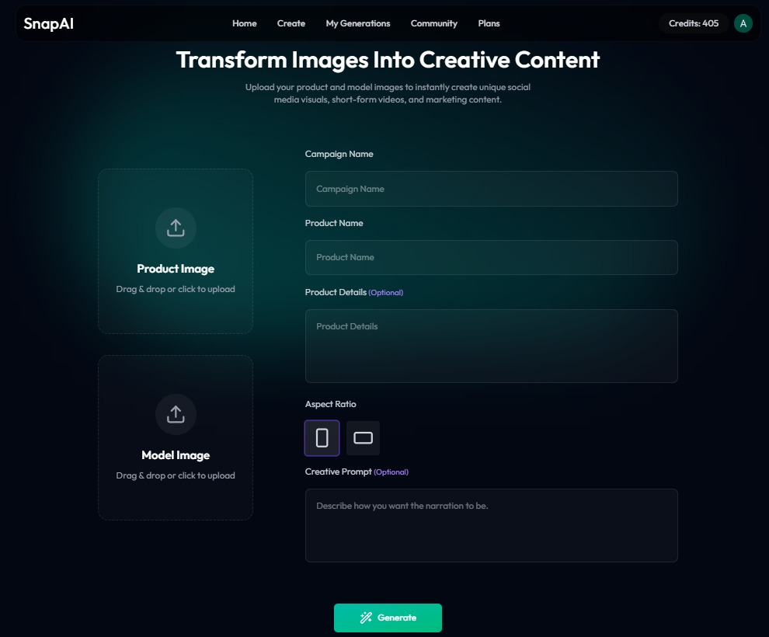
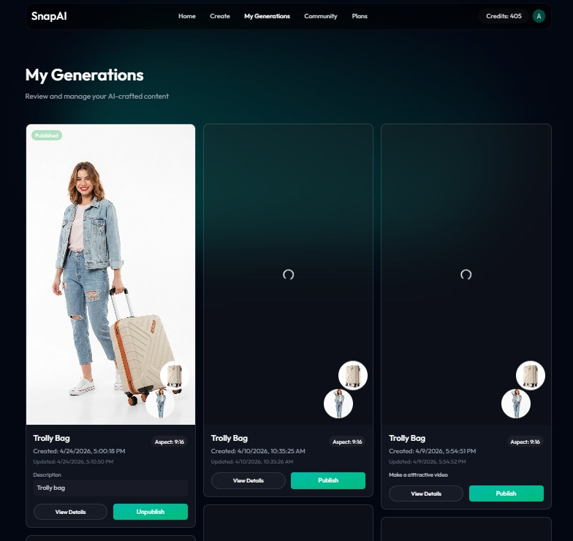
Screenshots

Slide 10
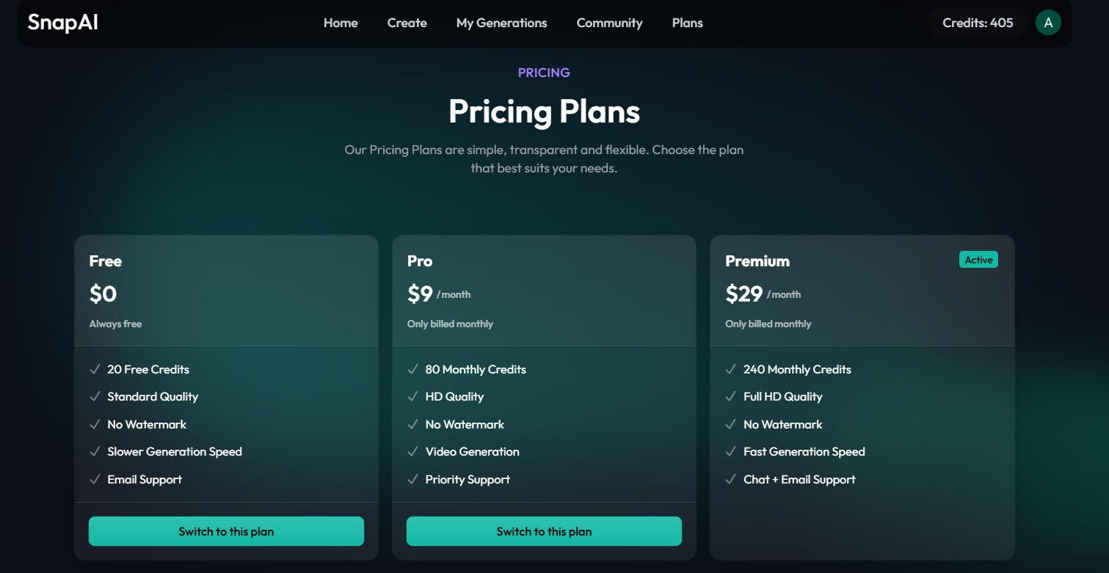
Screenshots

Slide 11
Conclusion
Artificial intelligence has the potential to revolutionize the way advertisements are created by making the process faster, smarter, and more efficient. Smart AI systems significantly reduce the time, effort, and cost involved in producing high-quality video ads, making it accessible even to small businesses and individuals. As technology continues to evolve, the future of digital advertising will focus on automation and personalization, enabling more targeted, engaging, and impactful content creation.

Slide 12
Thank You
12

